Slide 1


Vehicle control unit(VCU)
Review-II
AY 2025-26
Capstone Project – Introduction (PROJ2999)
GITAM (Deemed-to-be) University
Department of Electrical Electronics and Communication Engineering
Project Team:
MANOHAR R
BHARATH J
CHANDU C
Project Mentor:
PRADYUMNA RAJAN GHOSH
Project In-charge:
SHUBASHISH TIWARI
www.gitam.edu

Slide 2
Objective and Goals
Objective
Analyze AUTOSAR layered architecture for a 2W EV VCU.
Design CAN communication for sensors, BMS, and motor controller.
Build torque, braking, and battery logic for the VCU.
Simulate EV control behaviour in MATLAB.
Validate using use-cases and system test-cases.
Goals
Main Goals
• Design a modular AUTOSAR-based VCU architecture for a 2-wheeler EV
• Develop a CAN communication framework between EV subsystems
• Build and simulate VCU control logic (throttle, brake override, battery safety) in MATLAB
• Create complete architecture, block, flow, and CAN diagrams
• Validate system behaviour using defined use-cases and test-cases
Additional Goals
• Explore integration of ABS, traction control, and advanced EV features
• Add diagnostic and safety mechanisms (CAN error handling, timeouts, limp mode)
• Study possibility of AUTOSAR Adaptive upgrade for future EVs
• Improve scalability and maintainability of EV control software
• Enable future OTA updates and remote diagnostics capability

Slide 3
Project Plan (Clearly mention milestone for objectives under each reviews)
Task / Milestone | Week 1 | Week 2 | Week 3 | Week 4 | Week 5 | Week 6 | Week 7 | Week 8 | Week 9 | Week 10 | Week 11 | Week 12
Requirement Study & Literature Survey | ████████ | ████████
Architecture Design (VCU + CAN) |  |  | ████████ | ████████
Behaviour Design (Flowcharts, Use-cases) |  |  |  |  | ████████ | ████████
MATLAB/Simulink Implementation |  |  |  |  |  |  | ████████ | ████████
Testing & Validation |  |  |  |  |  |  |  |  | ████████ | ████████
Documentation & Final PPT |  |  |  |  |  |  |  |  |  |  | ████████ | ████████

Slide 4
Literature Survey
Key Publications
• AUTOSAR-based EV Control Systems – architecture, BSW, RTE, SWC design
• CAN Bus in Electric/Hybrid Vehicles – message structure, arbitration, reliability
• VCU Design for Electric Vehicles – motor control, torque mapping, safety logic
• Regenerative Braking Strategies in EVs – torque blending & energy recovery
• CAN Diagnostics & Security – error handling, IDS & fault detection
• Model-Based Development for Automotive ECUs – MATLAB/Simulink workflows
Key Resources
• Two-wheeler EV Platform Application Notes (VCU–BMS–MCU interfaces)
• OEM & Tier-1 AUTOSAR documentation and training notes
• CAN (ISO 11898) protocol overview + application design notes
• Motor controller datasheets (torque command structure, CAN communication)
• Battery Management System documentation (voltage, SoC message formats)
• Automotive safety & diagnostics guidelines (UDS basics, error codes)
Existing Implementations
• Commercial 2W EV platforms with VCU–BMS–MCU CAN integration
• Open-source CAN stack implementations and EV CAN message databases
• GitHub EV controller projects (VCU logic prototypes, CAN monitoring tools)
• Academic EV motorcycle/scooter VCU designs and thesis implementations
• Open-source regenerative braking control demos (MATLAB-based)
• CAN analyser tools (open-source) showing real-time EV CAN decoding

Slide 5
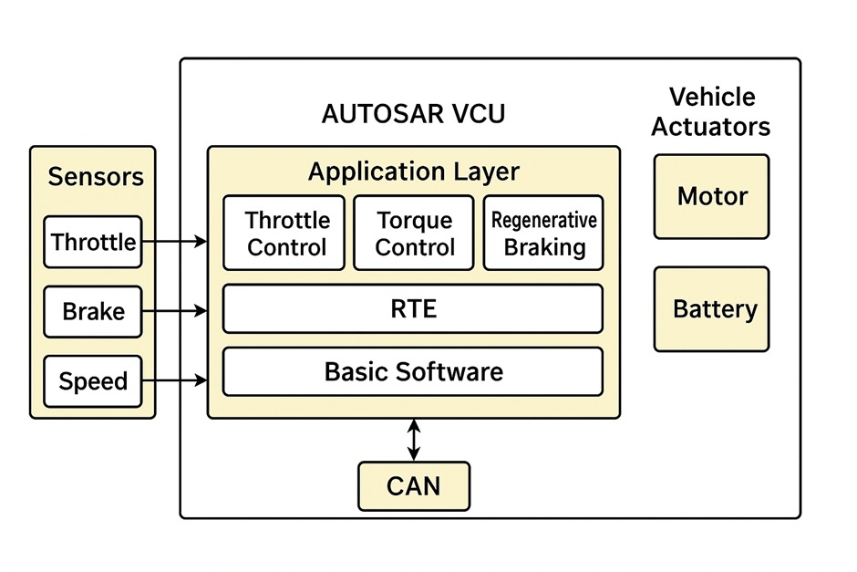
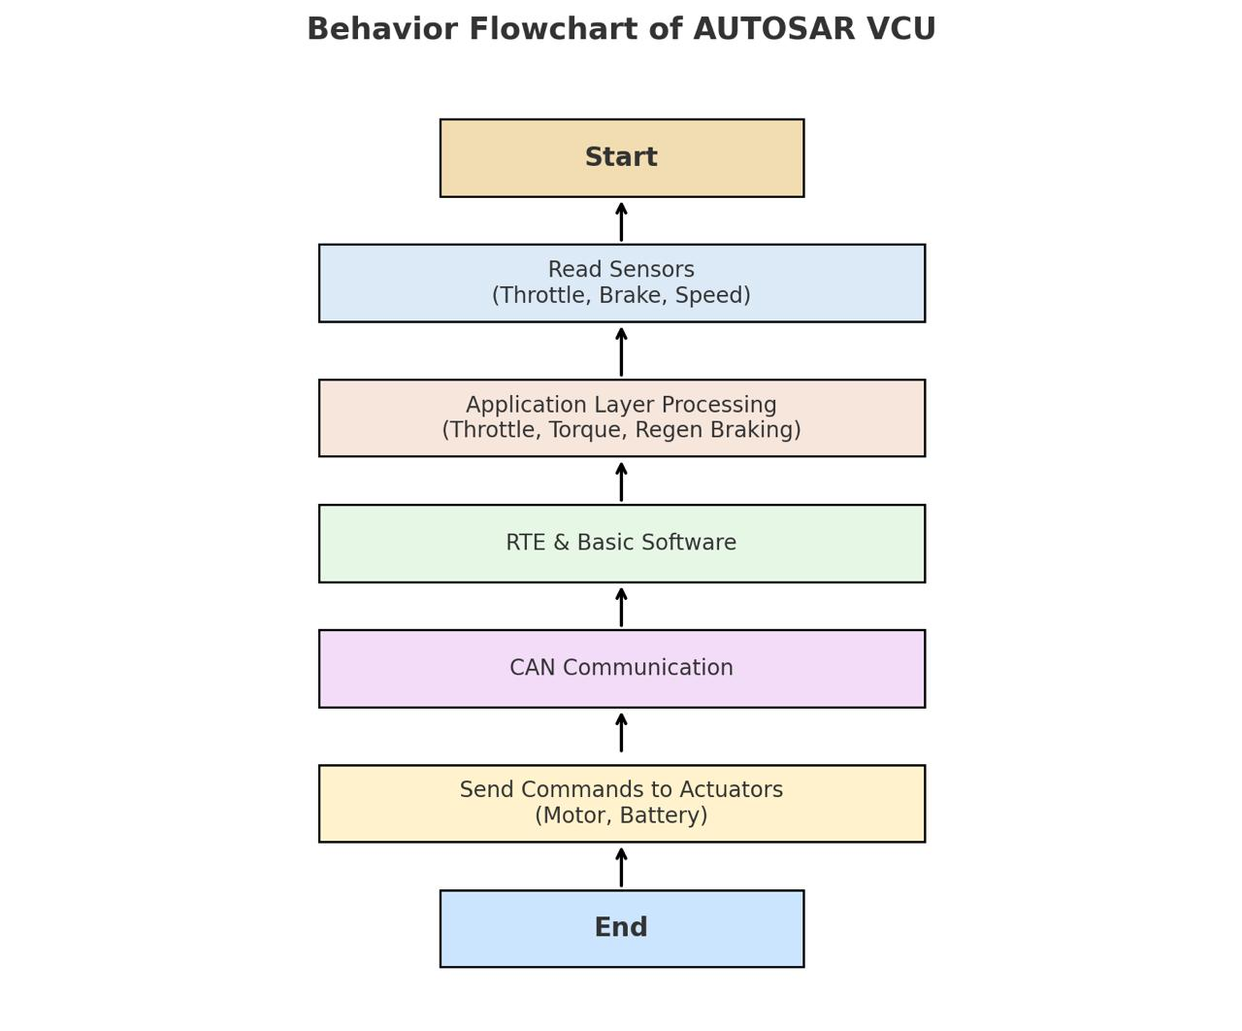
Architecture
Structural Diagram
Behaviour Diagram

Slide 6
Use Cases & Testing
Use Cases
Use Case ID | Use Case Name | Description | Actors | Preconditions | Postconditions
UC-01 | Vehicle Start/Stop | Control unit manages power-on and power-off sequences safely. | Rider, VCU | Battery connected, key ON | Motor ready to run or vehicle shut down safely
UC-02 | Motor Control | VCU regulates motor speed, torque, and direction via CAN bus. | Rider, VCU | Vehicle started | Motor speed matches rider input (throttle/brake)
UC-03 | Battery Monitoring | VCU monitors battery voltage, SOC (State of Charge), and temperature. | VCU, Battery | Battery connected | Alerts if battery low or overheated
UC-04 | Dashboard Display | VCU sends data to dashboard via CAN (speed, battery, warnings). | VCU, Dashboard | Vehicle powered ON | Rider sees real-time vehicle data
UC-05 | Fault Detection | VCU detects system faults like overcurrent, sensor failure. | VCU | Vehicle powered ON | Fault warning triggered, vehicle limited or stopped
UC-06 | Regenerative Braking | VCU controls braking energy recovery to battery. | Rider, VCU | Vehicle in motion, brake applied | Energy sent to battery, speed reduced smoothly
UC-07 | CAN Communication | VCU exchanges messages with motor controller, dashboard, and sensors. | VCU, ECUs | VCU and ECUs powered ON | Reliable communication without errors

Slide 7
TEST CASES
TEST CASES
Test Case ID | Test Description | Input | Expected Output | Pass/Fail Criteria
TC-01 | Start Vehicle | Turn key ON | Motor powers up, dashboard shows READY | Motor and dashboard respond correctly
TC-02 | Motor Speed Control | Throttle input 0–100% | Motor speed changes proportionally | Speed follows throttle input accurately
TC-03 | Battery Low Warning | Discharge battery to 20% SOC | Dashboard shows battery low alert | Alert displayed at correct SOC
TC-04 | Overcurrent Protection | Simulate motor overcurrent | VCU limits current, triggers warning | Motor current limited, warning triggered
TC-05 | CAN Message Transmission | Send speed data to dashboard | Dashboard receives accurate speed data | Data matches transmitted values
TC-06 | Regenerative Braking | Apply brakes at 30 km/h | Motor reverses torque, battery charges | Braking smooth, battery SOC increases
TC-07 | Sensor Failure Detection | Disconnect wheel speed sensor | VCU triggers fault warning | Dashboard displays fault, vehicle slows or stops
TC-08 | Vehicle Shutdown | Turn key OFF | Motor stops, dashboard powers down | Vehicle shuts down safely without error

Slide 8
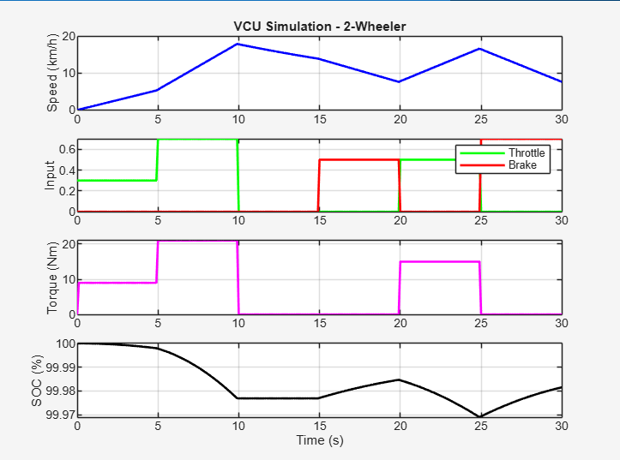
Implementation and Results

Slide 9
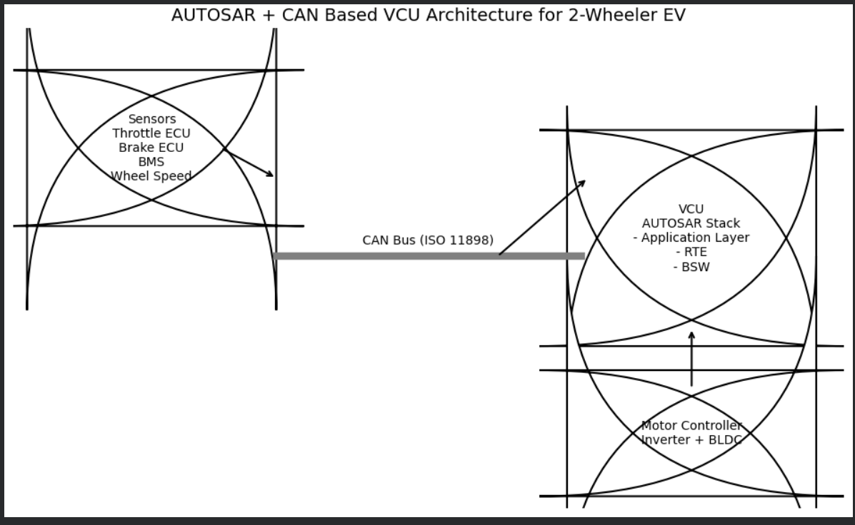
Implementation and Results

Slide 10
Conclusion & Future Work
Conclusion
• The project successfully analyzed and designed an AUTOSAR-oriented Vehicle Control Unit (VCU) architecture for a 2-wheeler electric vehicle.
• A complete CAN communication framework was defined for sensors, BMS, VCU, and motor controller.
• Essential VCU control logic including throttle processing, brake override, torque mapping, and battery protection was developed and simulated.
• MATLAB simulation results validated the behaviour of the proposed VCU, demonstrating correct torque response, safety prioritisation, and low-battery torque limitation.
• Overall, the project delivers a scalable, modular, and industry-relevant control architecture suitable for modern 2-wheeler EV platforms.
Future Work
• Integrate ABS, traction control, and ride-mode selection into the VCU for advanced vehicle dynamics control.
• Extend AUTOSAR-Classic design toward AUTOSAR Adaptive for enhanced communication, diagnostic, and OTA capabilities.
• Implement regenerative braking optimisation and energy-efficient torque strategies.
• Add cybersecurity, intrusion detection, and encrypted CAN communication for improved EV safety.
• Move toward Hardware-in-the-Loop (HIL) testing and integration with real motor controller/BMS hardware.
• Develop a full production-grade VCU firmware using embedded C, MCAL drivers, and AUTOSAR configuration tools.

Slide 11
THANK YOU
Have a Great Day !

